Slide 1
Solving complex data display issues with Dynamic VisualForce Components
John M. Daniel
FinancialForce.com
@ImJohnMDaniel

Slide 2

John M. Daniel
Product Services Team
FinancialForce.com
Certified Platform Builder II
Certified Advanced Developer
Certified Admin
Certified Service Cloud Consultant
@ImJohnMDaniel

Slide 3

About
GREAT ALONE. BETTER TOGETHER.
Native to Salesforce App Cloud since 2009
Investors include Salesforce Ventures
Customers in 27 countries
650+ employees, San Francisco based
Dreamforce.FinancialForce.com
Notes:
First, a few quick words about FinancialForce.com.
FinancialForce.com builds ERP apps that are native to the Salesforce App cloud including Accounting, professional services automation, Human resources and Inventory applications. Our apps can be subscribed to separately or part of a whole ERP family.
Our company investors include Salesforce Ventures, which made their original investment in us in 2009.
We have customers all around the world in 27 countries and over 650 employees including those at our headquarters on 595 Market St. here in San Francisco.
We have quite few sessions and parties planned here this week, you can learn more about those at Dreamforce.Financialforce.com. Feel free to join us.

Slide 4
Overview
Standard VisualForce Pages
What are they good at?
Where do they fall short? …and Why?
Dynamic VisualForce Components
Why do they help?
How do they help?

Slide 5
Standard VisualForce Pages
What are they good at?

Slide 6
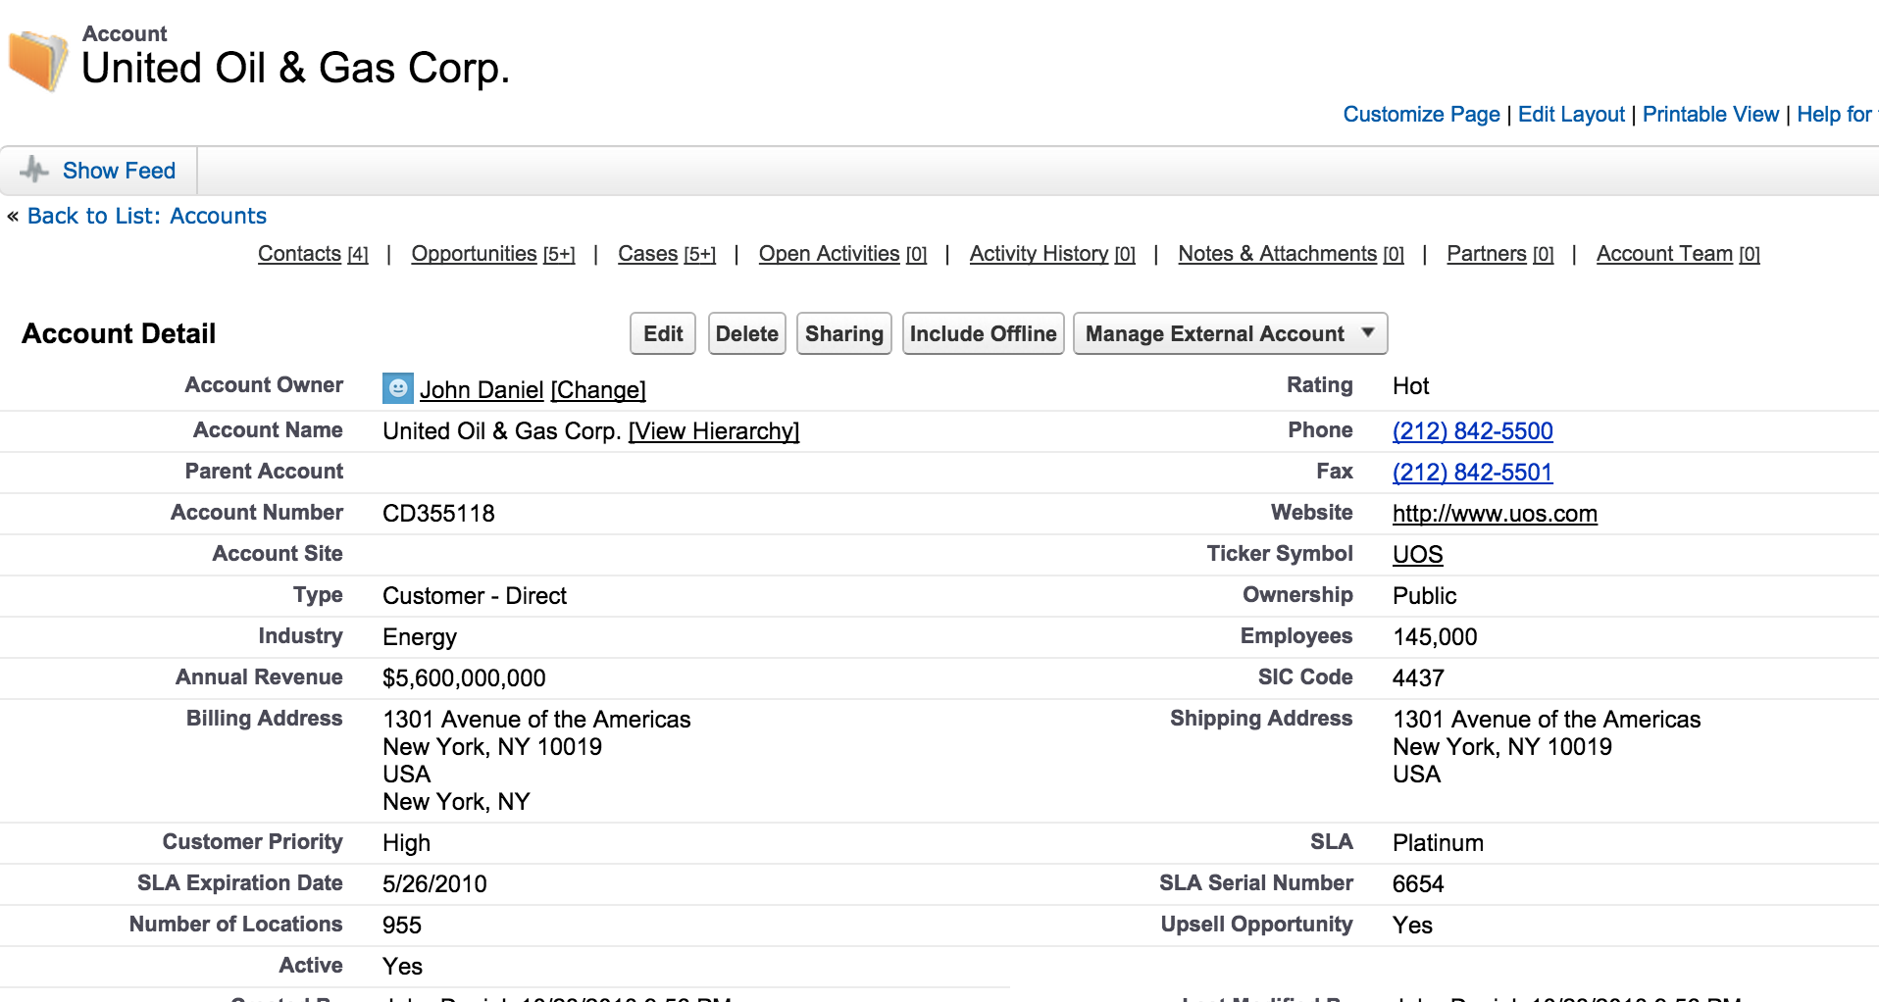
Standard VisualForce Pages
What are they good at?
Standard Record Detail UI

Slide 7
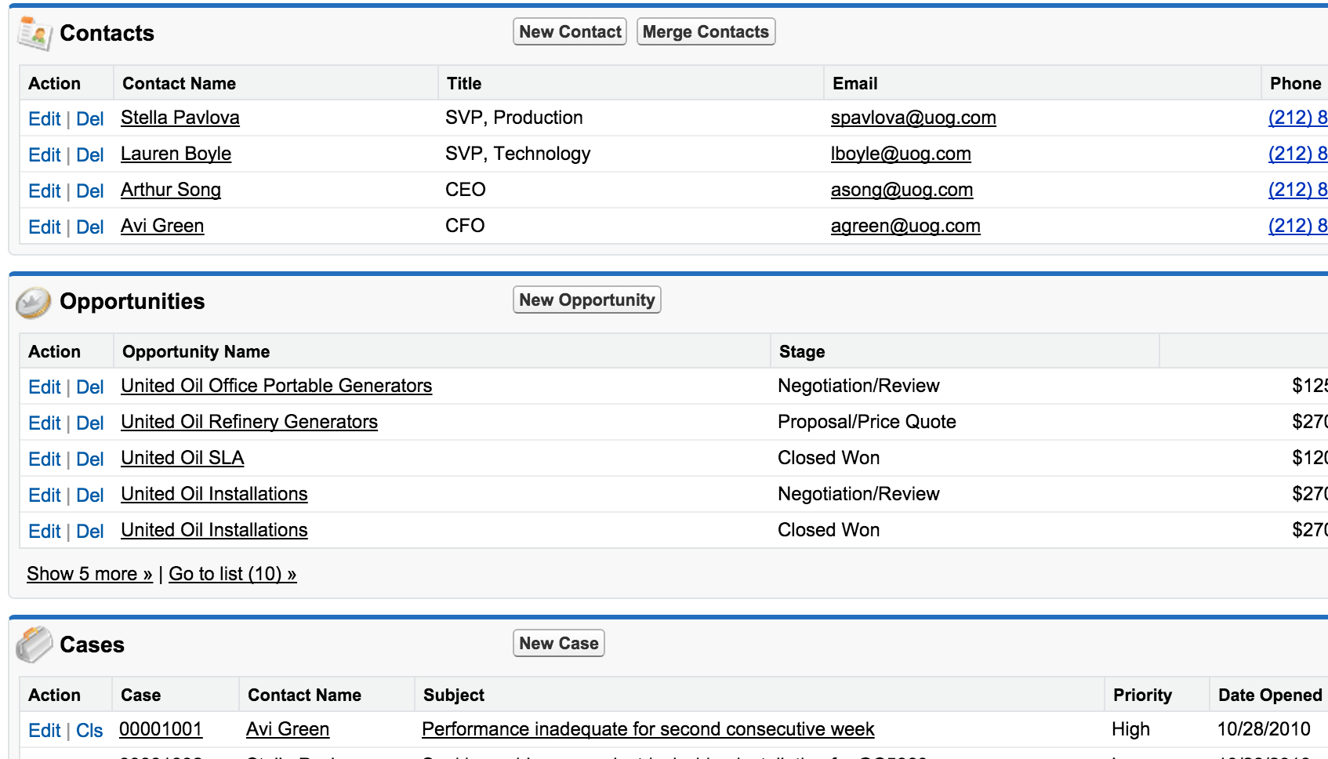
Standard VisualForce Pages
What are they good at?
Standard Record Detail UI
Related Records for a
Detail View

Slide 8
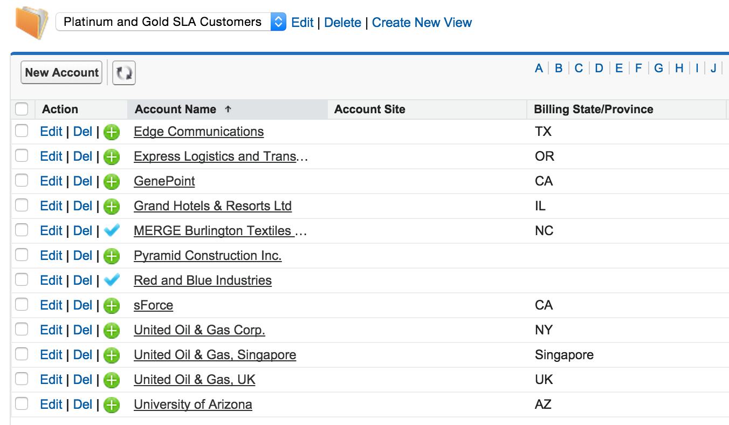
Standard VisualForce Pages
What are they good at?
Standard Record Detail UI
Related Records for a
Detail View
Standard Record
List View UI

Slide 9
Standard VisualForce Pages
Where do they fall short?

Slide 10
Standard VisualForce Pages
Where do they fall short?
Display of Hierarchy/Tree organized data

Slide 11
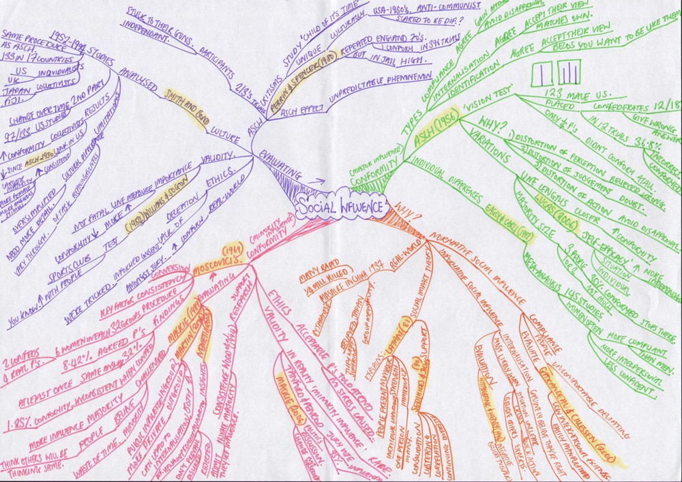
Standard VisualForce Pages
Where do they fall short?
Display of Hierarchy/Tree organized data
Social Influence Mapping

Slide 12
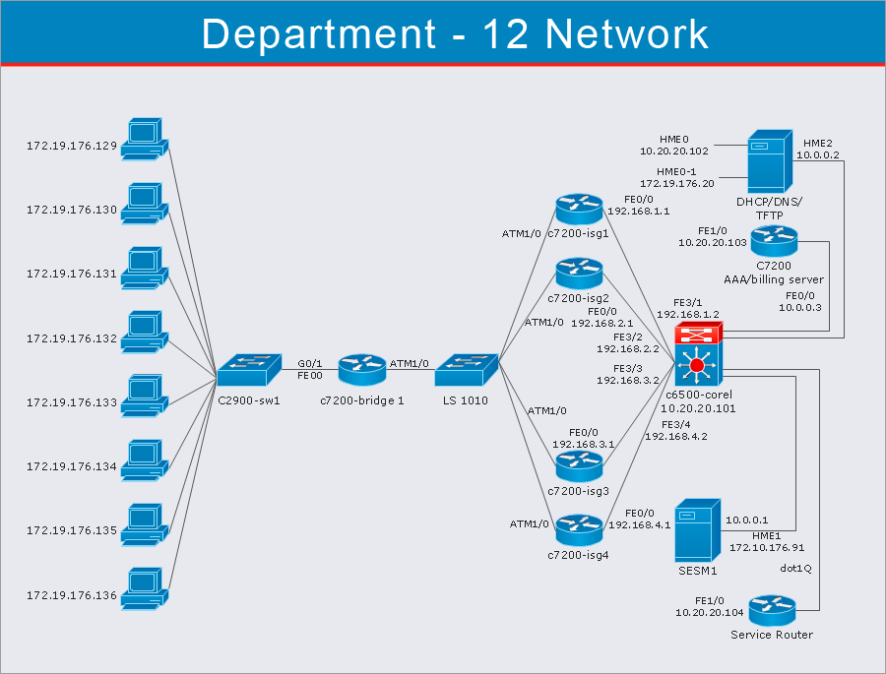
Standard VisualForce Pages
Where do they fall short?
Display of Hierarchy/Tree organized data
Social Influence Mapping
Network Device Mapping

Slide 13
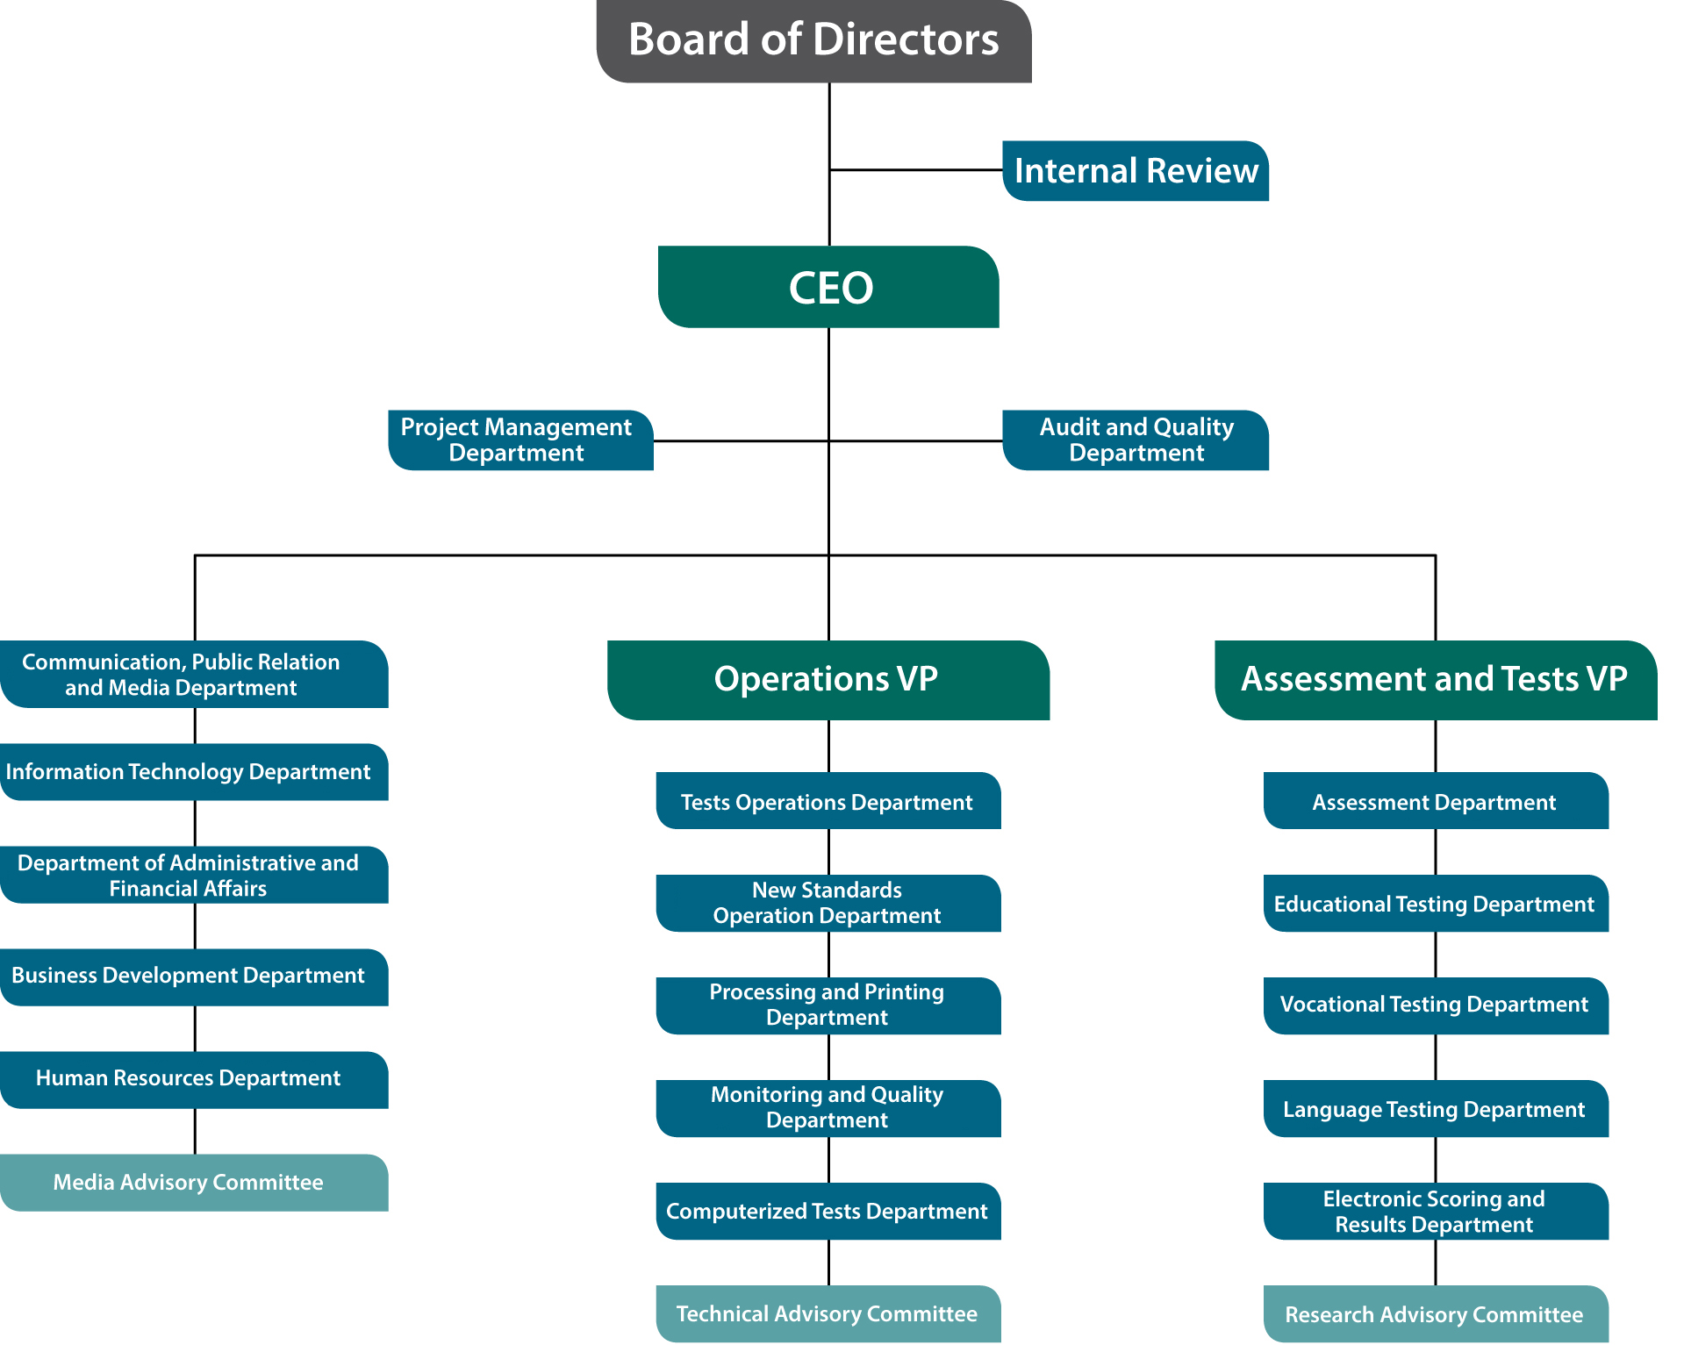
Standard VisualForce Pages
Where do they fall short?
Display of Hierarchy/Tree organized data
Social Influence Mapping
Network Device Mapping
Organizational Charts

Slide 14
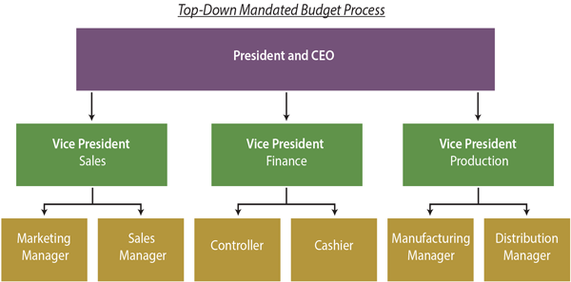
Standard VisualForce Pages
Where do they fall short?
Display of Hierarchy/Tree organized data
Social Influence Mapping
Network Device Mapping
Organizational Charts
Organizational Budgets

Slide 15
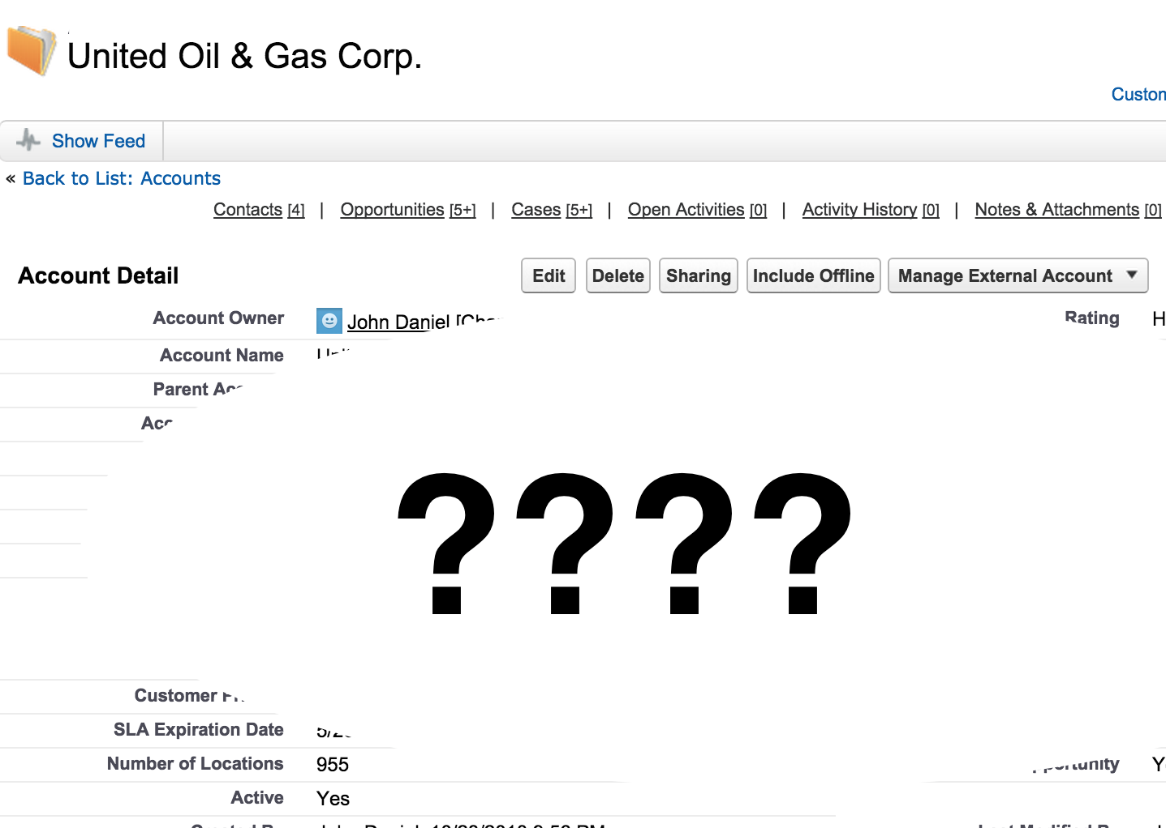
Standard VisualForce Pages
Where do they fall short?
Display of Hierarchy/Tree organized data
Social Influence Mapping
Network Device Mapping
Organizational Charts
Organizational Budgets
Display of SObjects / Objects when the type is not known till runtime.

Slide 16
So… Why does VisualForce fall short in these situations?

Slide 17
Standard VisualForce Pages
Why does VisualForce fall short in these situations?
The Document Object Model (DOM) is not predefined.
It changes with each record.
The layout cannot be guaranteed

Slide 18
Dynamic VisualForce Components
What are they?
How do they work?

Slide 19
Dynamic VisualForce Components
What are they and how do they work?
Move the markup out of the VisualForce page and into the Apex class.
Defined in Apex using a series of classes from the “ApexPages.Component” namespace.
For most every VisualForce tag, there is an equivalent Component tag.
<apex:outputText/> tag becomes Component.Apex.OutputText class
<apex:dataTable/> tag becomes Component.Apex.DataTable class
<apex:sectionHeader/> tag becomes Component.Apex.SectionHeader class
Custom Components in the same manner
<c:myCustomComponent/> tag becomes Component.c.MyCustomComponent class
This pattern works for managed packaged custom components as well.
<foobar:appCustomComponent/> tag becomes Component.foobar.AppCustomComponent class

Slide 20
Dynamic VisualForce Components
What are they and how do they work?
The basic pattern emerges as:
Component.Component_namespace.Component_name
For the <apex:outputText/> tag …
Namespace => “apex”
Component Name => “outputText”
So <apex:outputText/> becomes …
Component.Apex.OutputText

Slide 21
Dynamic VisualForce Components
What are they and how do they work?
VisualForce tag attributes are treated as class variables:
<apex:outputText value=“Hello World” styleClass=“app-style-1” label=“Field Output” rendered=“true”/>
becomes
Component.apex.outputText theOutputText = new Component.apex.outputText();
theOutputText.value = “Hello World”;
theOutputText.styleClass = “app-style-1”;
theOutputText.label = “Field Output”;
theOutputText.rendered = “true”;

Slide 22
Dynamic VisualForce Components
What are they and how do they work?
VisualForce tags with expression statements work in a similar manner.
<apex:detail subject=“{! Account.ownerId }” relatedList=“false” title=“false”/>
Would become…
Component.Apex.Detail dynDetail = new Component.Apex.Detail();
dynDetail.relatedList = false;
dynDetail.title = false;
detail.expressions.subject = '{!Account.ownerId}’;

Slide 23
Dynamic VisualForce Components
What are they and how do they work?
<apex:dynamicComponent componentValue=“myDynamicMarkeup”/>
Apex code equivalent using Dynamic VisualForce Components.
Component.Apex.Form dynForm = new Component.Apex.Form();
Component.Apex.PageBlock dynPageBlock = new Component.Apex.PageBlock();
// Create a Label for the input field
Component.Apex.OutputLabel theLabel = new Component.Apex.OutputLabel();
theLabel.value = ’Name';
theLabel.for = 'theName';
// Create an input field for Account Name
Component.Apex.InputField theNameField = new Component.Apex.InputField();
theNameField.expressions.value = '{!Account.Name}';
theNameField.id = 'theName';
// Add input field and label to page block
dynPageBlock.childComponents.add( theLabel );
dynPageBlock.childComponents.add( theNameField );
// Add the page block to the form
dynForm.childComponents.add( dynPageBlock );
<apex:outputLabel for=“theName” value=“Name” />
<apex:inputField value=“{! Account.Name }”
id=“theName” />
VisualForce pages are a series of tags nested one in the other.
<apex:form>
<apex:pageBlock>
</apex:pageBlock>
</apex:form>
VisualForce pages are a series of tags nested one in the other.
<apex:form>
</apex:form>

Slide 24
Code Example
Dynamic VisualForce Components

Slide 25
It has its niche!

Slide 26
Questions???

Slide 27
Links
Dreamforce ‘15 DevZone Presentations
https://github.com/developerforce/df15-devzone-presentations
Visualforce Developer’s Guide: Dynamic Visualforce Components
https://developer.salesforce.com/docs/atlas.en-us.pages.meta/pages/pages_dynamic_vf_components_intro.htm
Force.com Apex Code Developer's Guide: Component Class
https://developer.salesforce.com/docs/atlas.en-us.apexcode.meta/apexcode/apex_pages_dynamic_components.htm
Dave Carroll’s demonstration of DVFC in Summer11 release
https://www.youtube.com/watch?v=ja82i82eKes#t=29m33s
DeveloperForce blog: “Dynamic Visualforce Components” by Kyle Thornton
https://developer.salesforce.com/page/Dynamic_Visualforce_Components

Slide 28




Share Your Feedback, and Win a GoPro!
Earn a GoPro prize entry for each completed survey
Tap the bell to take a survey
1
Enroll in a session
2
3

Slide 29
Thanks! Enjoy #DF15 !!!

